Slide 1




SMART INDIA HACKATHON 2026
TITLE PAGE
  Problem Statement ID – SIH26003
  Problem Statement Title- AI-Based Cognitive Gaming and Memory Assistance Platform for Elderly Dementia Patients in North Eastern Region (NER)
  Theme- MedTech/BioTech/HealthTech
  PS Category- Software
  Team ID-
  Team Name- Cyber Solver

Slide 2
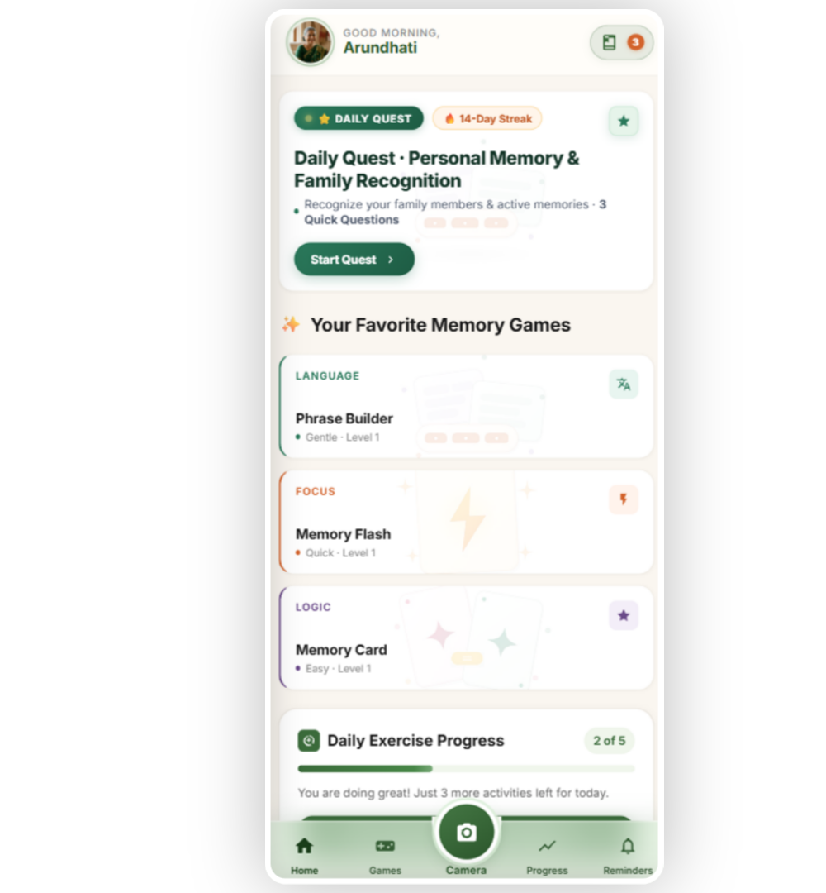
SMRITI SANJIVANI
Cyber Solver
AI-powered mobile-first app which acts as a personal brain-trainer for elderly users in north-east region of India. It combines cognitive games, reminders and culturally-infused interface.
  AI adaptive gaming - Aimed at active-recalling, memory-boosting, pattern recognition and emotional-engagement
  Cognitive performance tracking - Daily analytics updated on dashboards
  Voice assisted and multi-lingual UI - Accessible and easy to use for senior citizens with hands free voice commands and spoken answers
  Offline-synchronization support - Functional in rural and low internet connectivity areas of NER
  Personalized dashboards - Separate dashboards for caregivers and patients that eases remote monitoring
  Reminders - For hydration, appointments, medicines
  Affordable - Replaces regular in-person therapy sessions
  Simple UI/UX design for elders - Elder-friendly navigation and mobile-first app
  Memory book – paitent can add and save their important works and memories as flash card.
2
Notes:
2

Slide 3
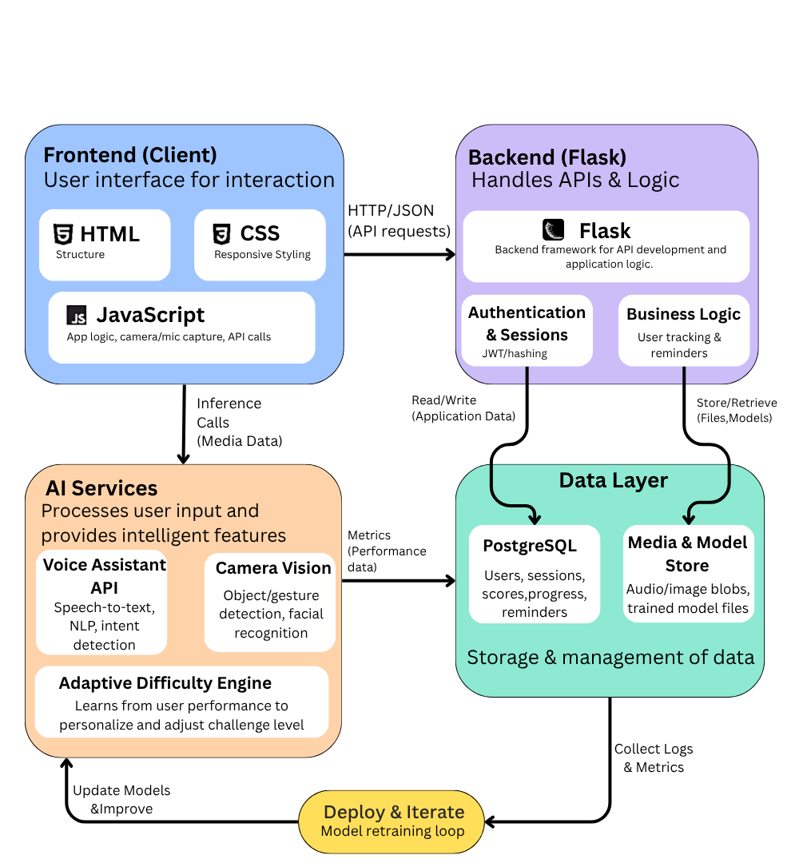
Cyber Solver
TECHNICAL APPROACH
  Frontend - HTML, CSS and JavaScript for web based application.
  REACT.JS - As a scalable and interactive framework
  FLASK - For lightweight backend in Python
  PostgreSQL - For Relational Database Management System.
  Numpy - Numerical processing of facial image data.
  FastAPI- Backend API development and integration.
  BHASHINI API - Enables multilingual translation and language support for regional languages.
3
Notes:
3

Slide 4
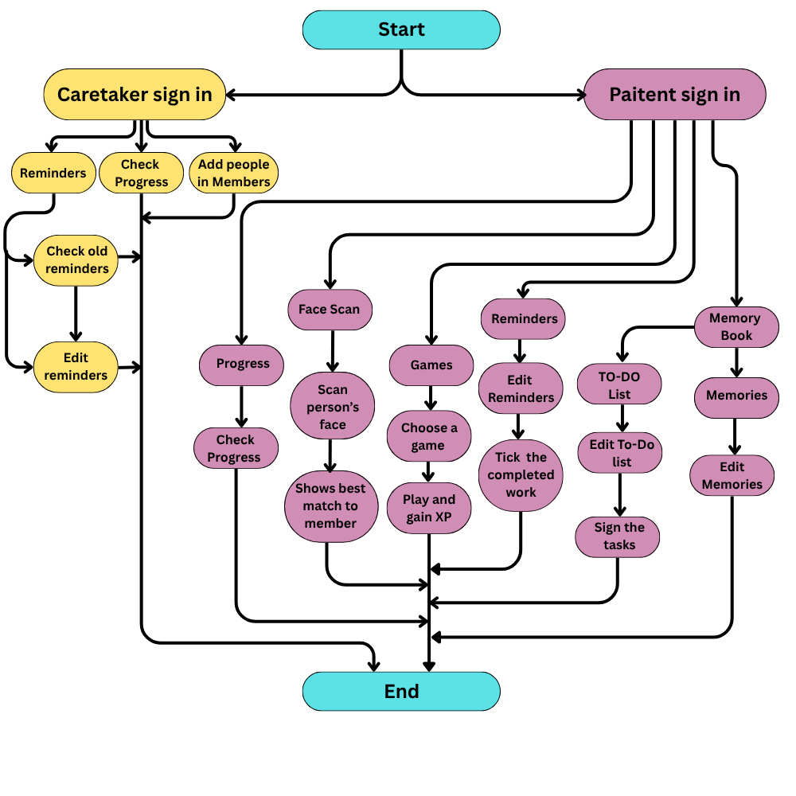
FEASIBILITY AND VIABILITY
Cyber Solver
  Feasibility of the idea
  Built specifically for NER therefore bridges the
healthcare gap
  Adaptive difficulty levels
  Mobile-first app with multi lingual functionality
  Works in low connectivity
  Cost effective
  Potential Challenges and Risks
  Digital literacy gap
  Voice recognition accuracy
  Not a diagnostic tool
  Strategies to Overcome Challenges
  Simple UI : Large icons + easy navigation
  Manual touch fallback for better accuracy
  Include disclaimers and recommend diagnosis
4
Notes:
4

Slide 5
IMPACT AND BENEFITS
Cyber Solver
Area | Impact
Early detection | Can catch memory decline 6–12 months sooner than usual
Cost | Cuts recurring therapy costs (₹500–2000/session) to near zero
Reach | One app can cover far more households than the handful of specialists NER currently has
Caregivers | Less need for constant supervision — dashboard handles the watching
Patients
  Slows cognitive decline
  Personalized difficulty level on the basis of performance
  Reduces isolation
  Emotional well being
  can save thier best memories
Caretaker
  Remote monitoring
  Real-Time alerts and warning signs
  Better co-ordination with patients
  Can handle multiple patients
5
Notes:
5

Slide 6
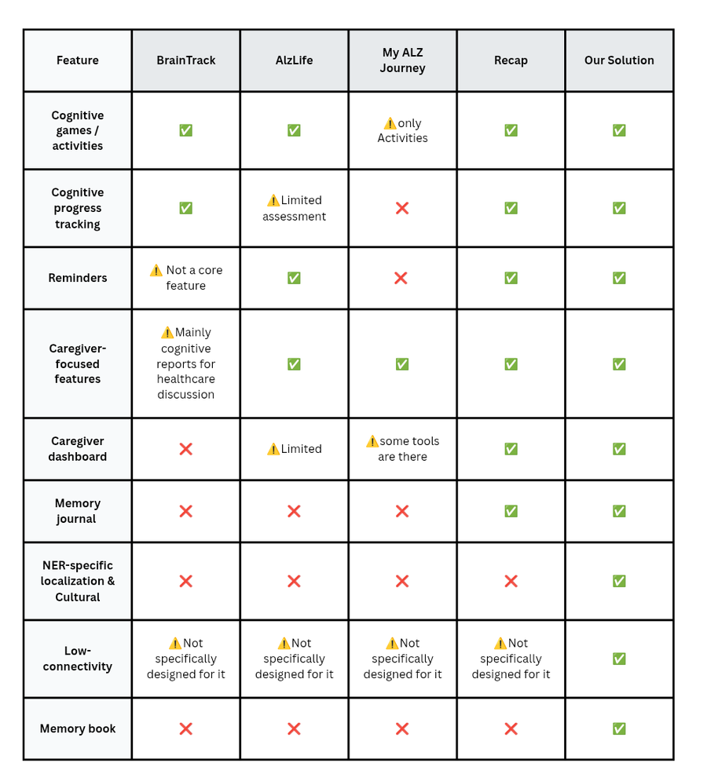
RESEARCH AND REFERENCES
Cyber Solver
  Refrences :
  Comparision with existing systems:
Research Paper:
  https://pubmed.ncbi.nlm.nih.gov/36191740/
  https://pubmed.ncbi.nlm.nih.gov/28539102/
Models used for research:
  OpenAi – ChatGPT classic
  Anthropic – Claude Sonet
6
Notes:
6

